Slide 1
Correspondences
Lecture 1 (75 minutes)
Photometric Matching
SIFT features and descriptors
Stereo and dense depth

Slide 2
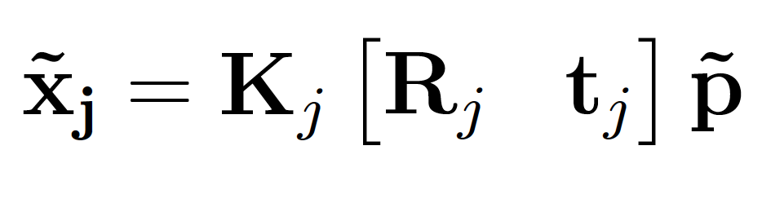
Correspondence is a core vision task
Graphics | ? | known | known | known
Calibration | known | ? | ? | known
Triangulation | known | known | known | ?
 | known | known | known | ?
2-frame SFM | known | known | ? | ?
 | known | known | ? | ?
Need it to estimate the 3D geometry of the world
2D to 2D matching of points
Also arises when comparing images over time, e.g. medical images

Slide 3
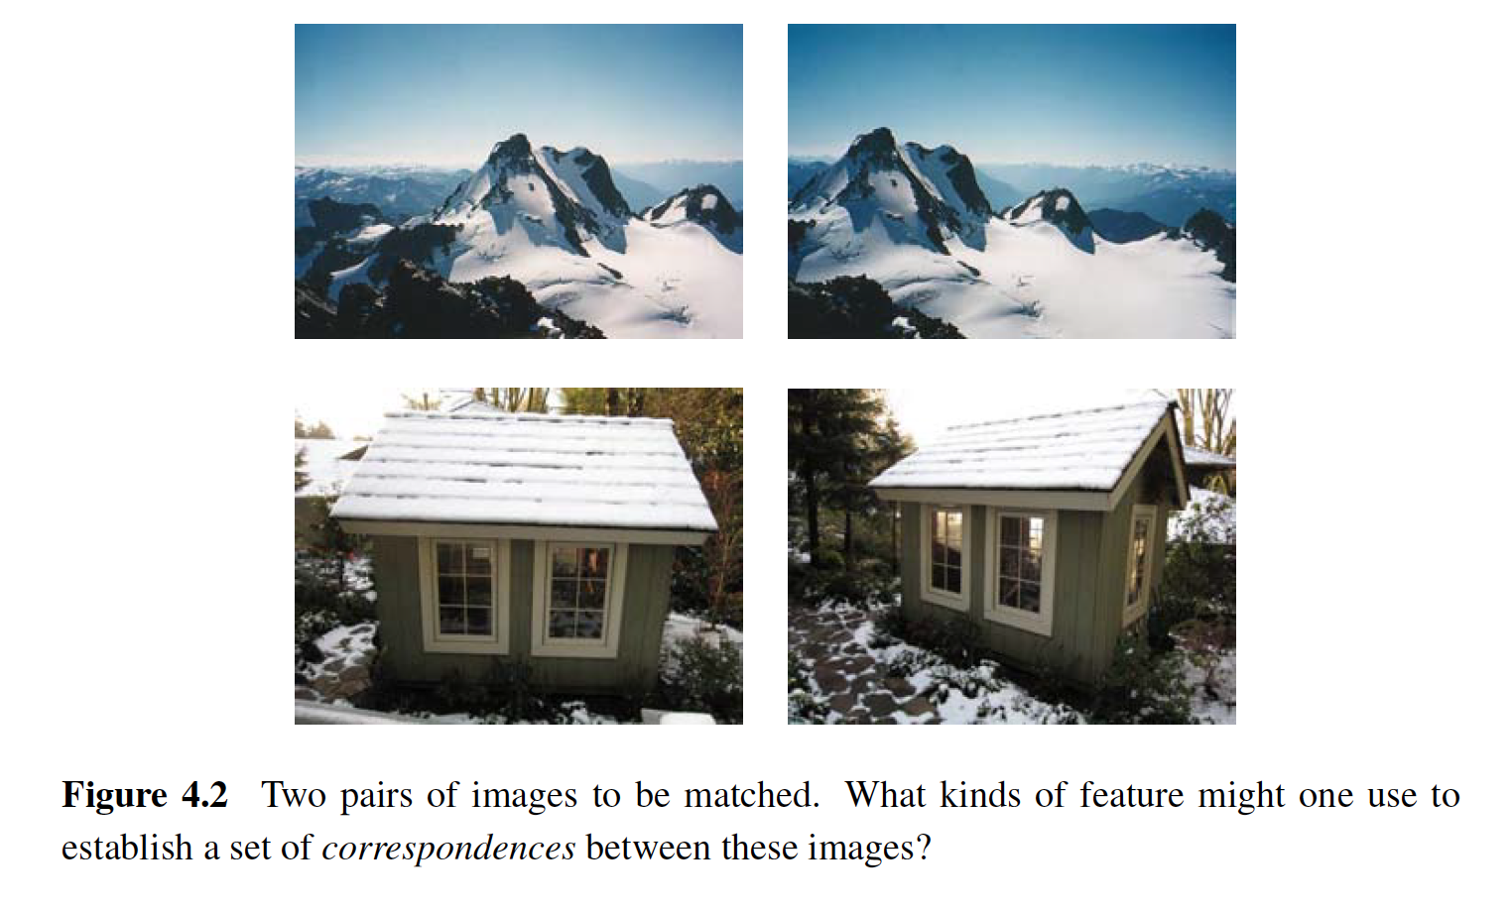
Small changes in view vs. large changes
Small baseline
Large baseline

Slide 4
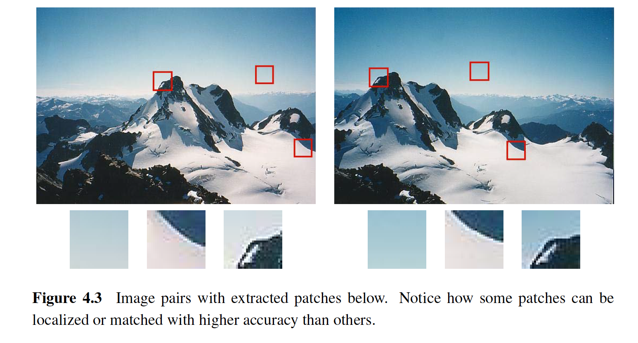
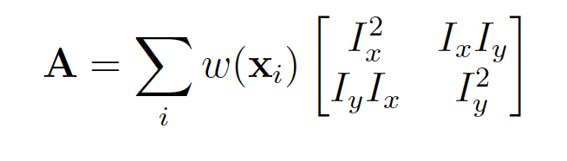
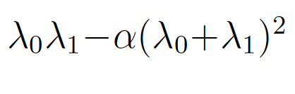
Remember first assignment - Harris detector?
Local Image Tensor

Slide 5
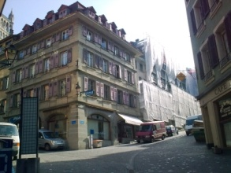
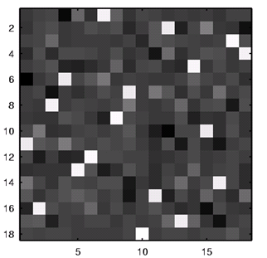
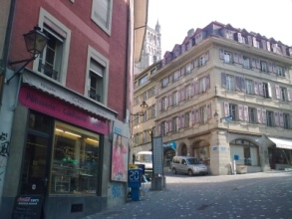
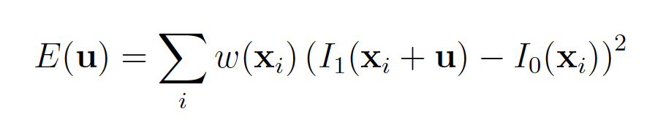
Correspondence using Photometric Matching
Consider the points on each image as two sets of nodes in a graph.
Link between the nodes are weighted by the feature similarity values.
Find the one-to-one combination that maximizes the total weight.
Bipartite graph matching
Hungarian algorithm
https://en.wikipedia.org/wiki/Hungarian_algorithm
Feature similarity matrix

Slide 6
Correspondence using Photometric Matching
Not all image points will have match in the other images
We must allow for null matches
a
1
b
2
c
3
d
4
e
null
null

Slide 7
More stable matching points
The local appearance of features will change in orientation and scale, and sometimes even undergo affine deformations
Simple patch difference does not work well
Another -- Extract a local scale, orientation, or affine frame estimate and then using this to resample the patch before matching.
Another - David Lowe’s Scale-Invariant Feature Transform Points (SIFT) points
Lowe, D.G. Distinctive Image Features from Scale-Invariant Keypoints. International Journal of Computer Vision 60, 91–110 (2004).
https://docs.opencv.org/master/da/df5/tutorial_py_sift_intro.html

Slide 8
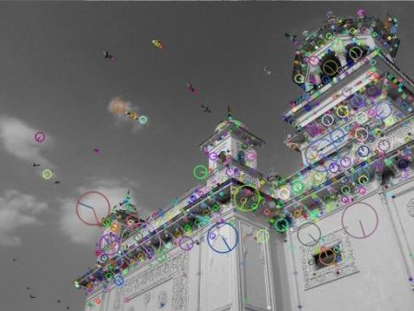
Typical output of SIFT (from OpenCV)

Slide 9
Overall Procedure at a High Level
Scale-space extrema detection
Search over multiple scales and image locations.
Keypoint localization
Fit a model to determine location and scale.
Select keypoints based on a measure of stability.
Orientation assignment
Compute best orientation(s) for each keypoint region.
Keypoint description
Use local image gradients at selected scale and rotation to describe each keypoint region
Credits: https://slideplayer.com/slide/5282534/)

Slide 10
1. Scale-space extrema detection
Goal: Identify locations and scales that can be repeatably assigned under different views of the same scene or object.
Method: search for stable features across multiple scales using a continuous function of scale.
Prior work has shown that under a variety of assumptions, the best function is a Gaussian function.
The scale space of an image is a function L(x,y,σ) that is produced from the convolution of a Gaussian kernel (at different scales) with the input image.
Credits: https://slideplayer.com/slide/5282534/)

Slide 11
Aside: Image Pyramids
And so on.
3rd level is derived from the
2nd level according to the same
funtion
2nd level is derived from the
original image according to
some function
Bottom level is the original image.
Credits: https://slideplayer.com/slide/5282534/)

Slide 12
Aside: Mean Pyramid
And so on.
At 3rd level, each pixel is the mean
of 4 pixels in the 2nd level.
At 2nd level, each pixel is the mean
of 4 pixels in the original image.
mean
Bottom level is the original image.
Credits: https://slideplayer.com/slide/5282534/)

Slide 13
Aside: Gaussian Pyramid At each level, image is smoothed and reduced in size.
And so on.
At 2nd level, each pixel is the result
of applying a Gaussian mask to
the first level and then subsampling
to reduce the size.
Apply Gaussian filter
Bottom level is the original image.
Credits: https://slideplayer.com/slide/5282534/)

Slide 14
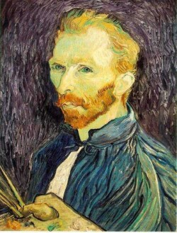


Example: Subsampling with Gaussian pre-filtering
G 1/8
G 1/4
Gaussian 1/2
Credits: https://slideplayer.com/slide/5282534/)

Slide 15
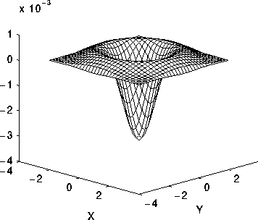
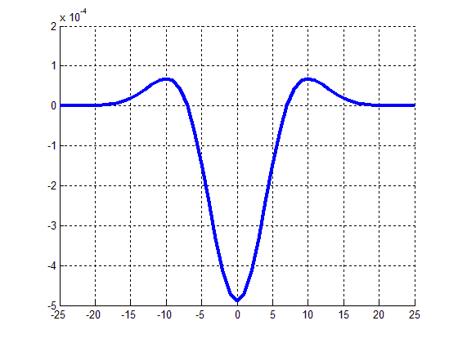
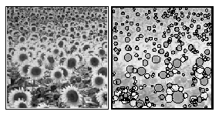
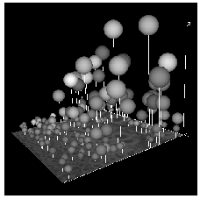
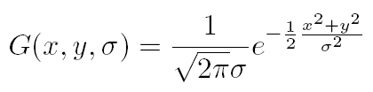
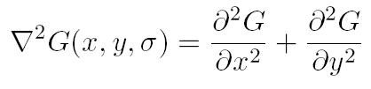
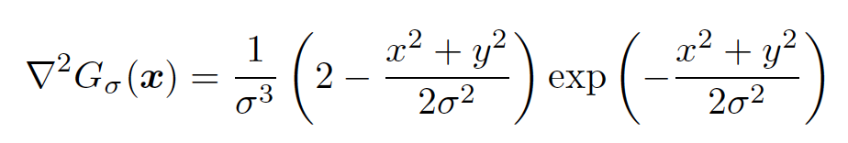
Lowe’s Scale-space Interest Points
Use second derivative of Gaussian to detect "spots” or “blobs”, i.e. salient points in images.
The Laplacian of Gaussian (LoG)
[ T. Lindeberg IJCV 1998 ]

Slide 16
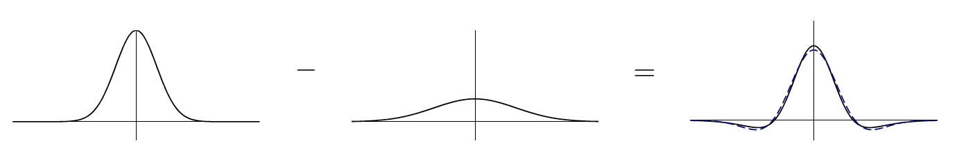
LoG can be approximated by DoG

Slide 17
Lowe’s Pyramid Scheme
Scale space is separated into octaves:
Octave 1 uses scale σ
Octave 2 uses scale 2σ
etc.
In each octave, the initial image is repeatedly convolved with Gaussians to produce a set of scale space images.
Adjacent Gaussians are subtracted to produce the DOG
After each octave, the Gaussian image is down-sampled by a factor of 2 t produce an image ¼ the size to start the next level.
Credits: https://slideplayer.com/slide/5282534/)

Slide 18
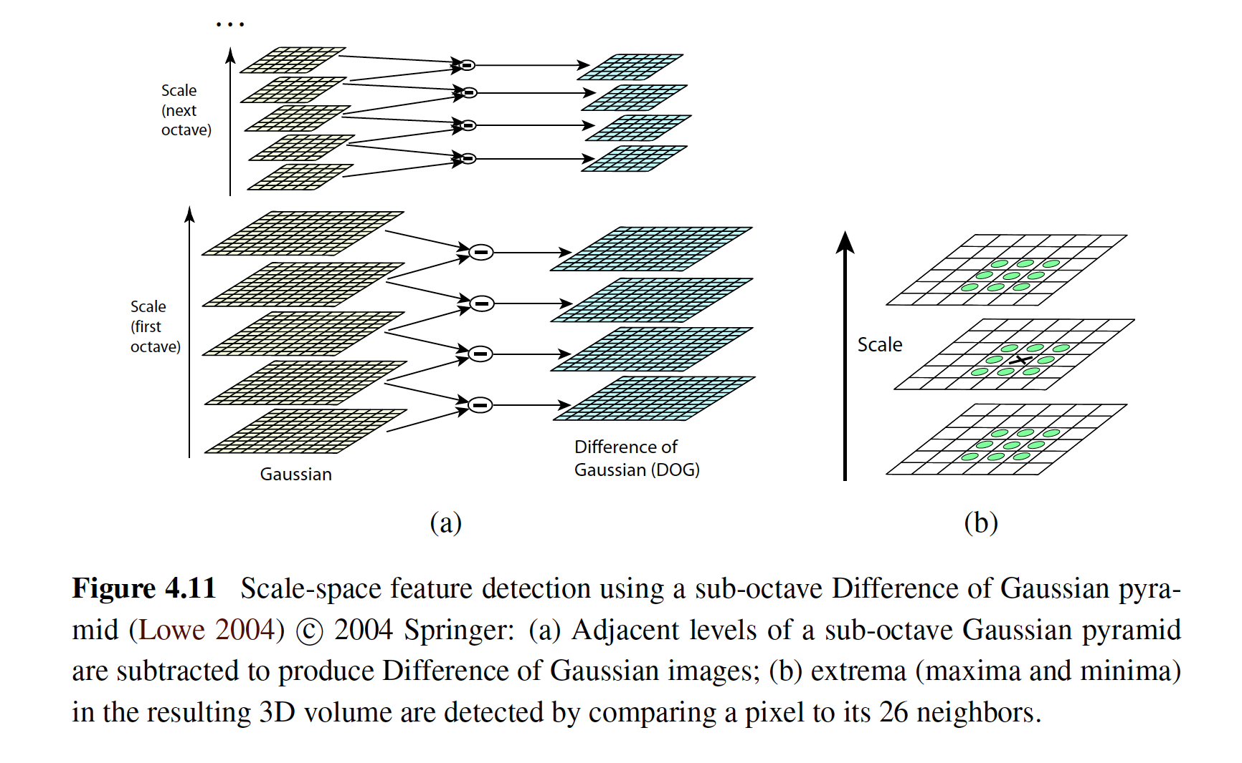
Find the local maxima across scale and space which gives us a list of (x,y,σ) values which means there is a potential keypoint at (x,y) at σ scale.
number of octaves = 4,
number of scale levels = 5

Slide 19
SIFT: Keypoint Localization and Screening
Localize the point more precisely in the original image grid using Taylor series expansion of scale space
Reject if intensity at this extrema is less than a threshold value (0.03).
Also responds to edges, so need to eliminate these maximas
2x2 Image tensor (Harris), one eigen value is larger than the other it is an edge (ratio > 10 in paper_.
So it eliminates any low-contrast keypoints and edge keypoints and what remains are strong interest points.

Slide 20
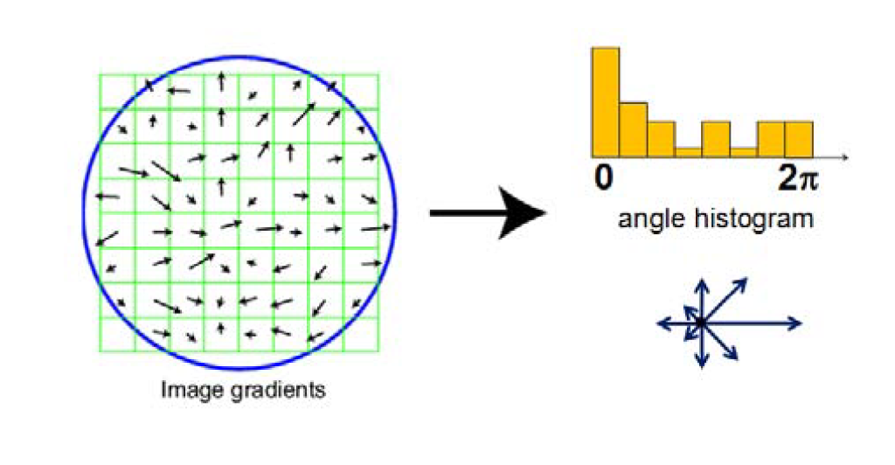
SIFT: Orientation Assignment
A SIFT keypoint is a circular image region with an orientation.
It is described by a geometric frame of four parameters:
the keypoint center coordinates,
its scale (the radius of the region), and
its orientation.

Slide 21
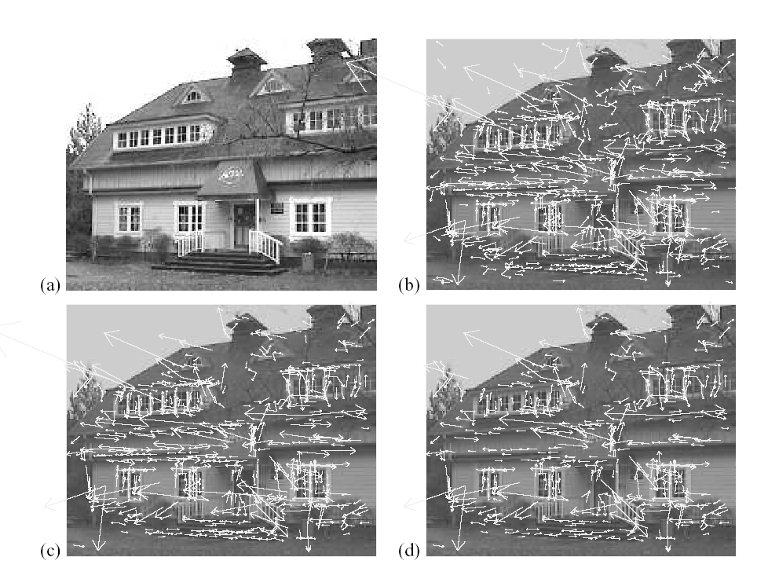
Keypoint localization with orientation
832
233x189
initial keypoints
536
729
keypoints after
gradient threshold
keypoints after
Hessian ratio threshold
Credits: https://slideplayer.com/slide/5282534/)

Slide 22
4. Keypoint Descriptors
At this point, each keypoint has
location
scale
orientation
Next is to compute a descriptor for the local image region about each keypoint that is
highly distinctive
invariant as possible to variations such as changes in viewpoint and illumination

Slide 23
Normalization
Rotate the window to standard orientation
Scale the window size based on the scale at which the point was found.
Credits: https://slideplayer.com/slide/5282534/)

Slide 24
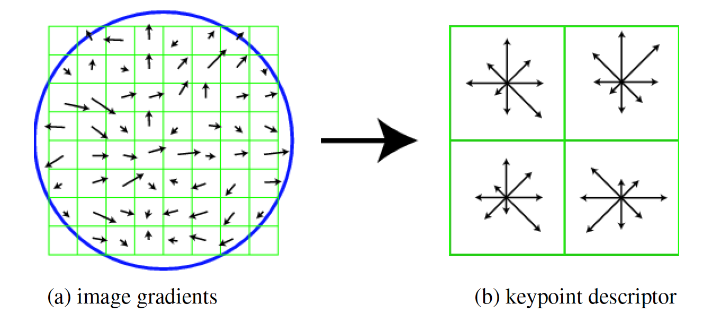
SIFT: Keypoint descriptor - powerful
A 16x16 neighbourhood around the keypoint is taken.
It is divided into 16 sub-blocks of 4x4 size.
For each sub-block, 8 bin orientation histogram is created.
The 3-D histogram (consisting of 8x4x4=128 bins) is stacked as a single 128-dimensional vector.
(illustrated only with 2 X 2 descriptors over 8 X 8)

Slide 25
The SIFT keypoint plus descriptor is invariant to translation, rotations, and re scaling of the image

Slide 26
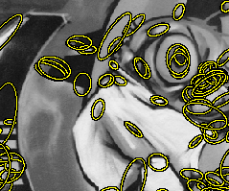
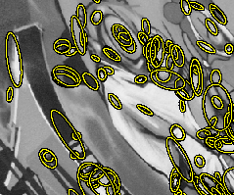
Many other features and descriptors
http://www.robots.ox.ac.uk/~vgg/research/affine/

Slide 27
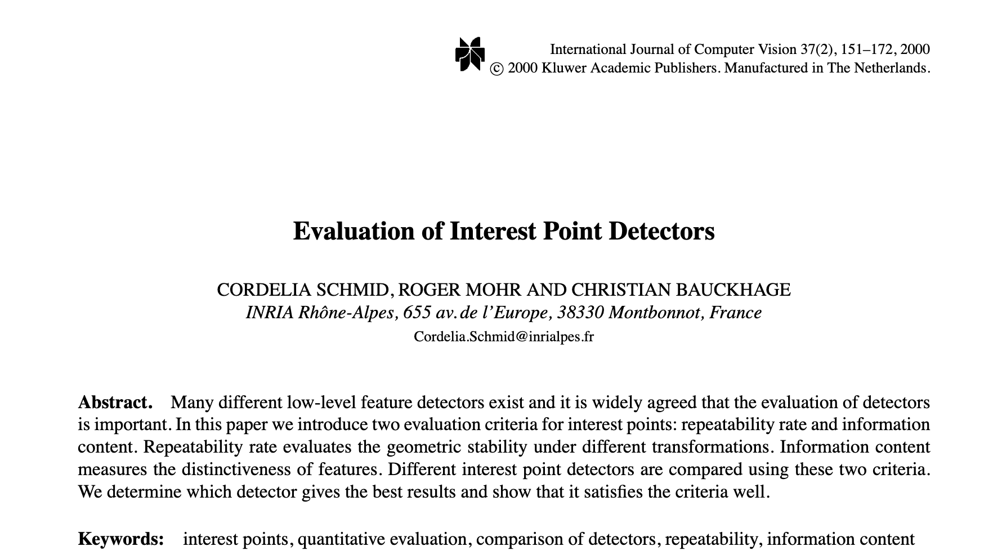

Slide 28
Practical considerations
Hungarian algorithm is O(N³), which is impractical for most applications.
Greedy (brute-force) method can be used with “robust” features with “rich” descriptors.
For each one feature in first set and is matched with all other features in second set using some distance calculation.
Return closest one.
O(N²) brute force matching is also not good for large images
Use indexing structure, such as
multi-dimensional hash table
k-d trees - see book by Hanen Samet.
Binary decision tree - indexed by dimensions
search is O(logN) instead of O(N).

Slide 29
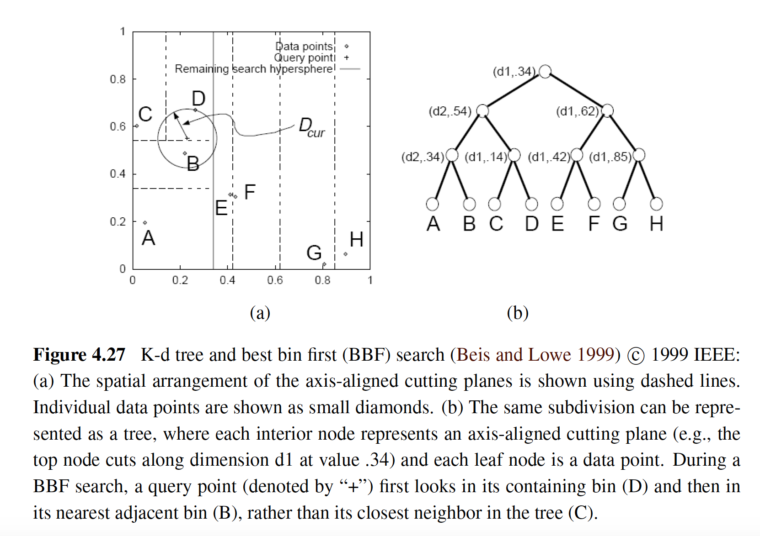

Slide 30
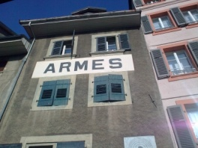
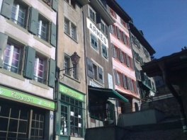
Matching Points: Wide baseline
Photometry (image-based appearance measure) is not enough

Slide 31
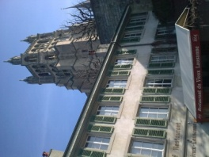
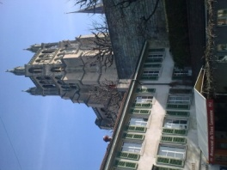

Narrow vs. Wide-Baseline

Slide 32
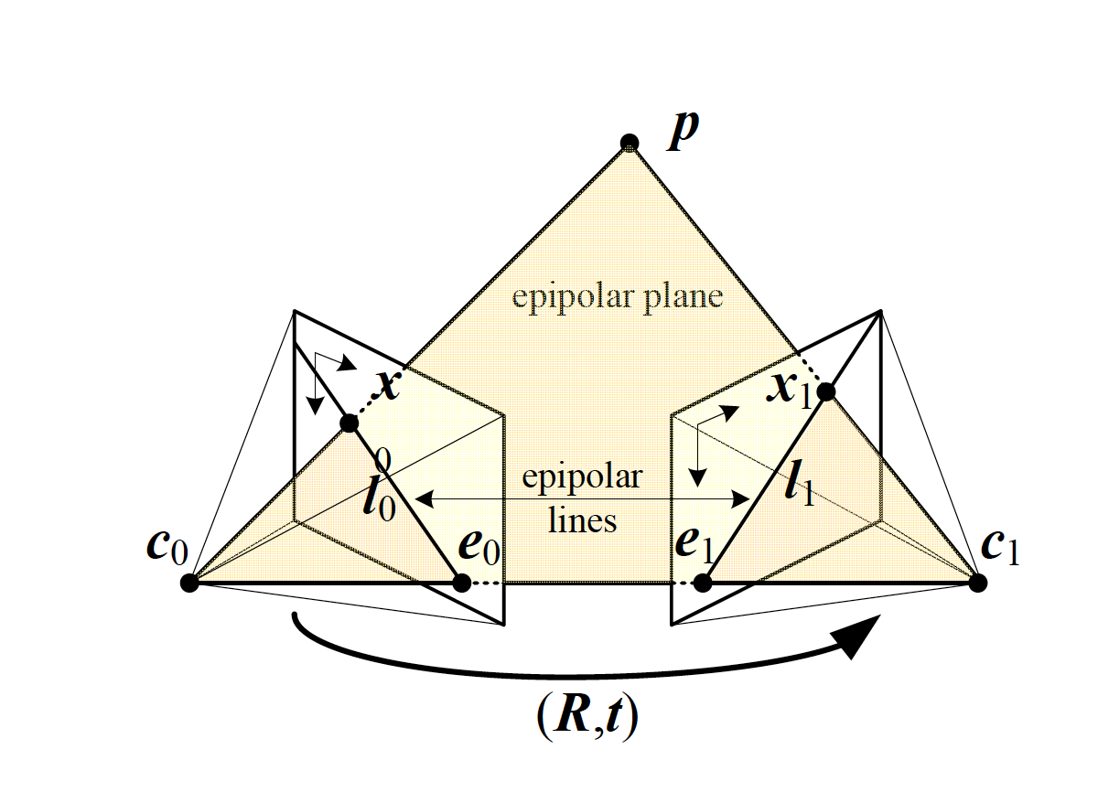
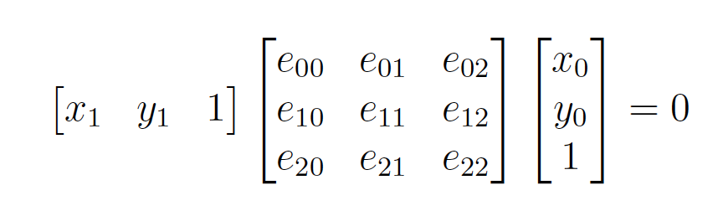
Matching points with Geometric constraints
Using image coordinates after
Intrinsic correction (Essential Matrix)

Slide 33
Pause for 5 mins
Given point (x₀, y₀) in one image, write the equation of the epipolar line in the other image.

Slide 34
Epipolar constraint
Given point (x₀, y₀), write the equation of the epipolar line in the other image.

Slide 35
Pause for 5 mins
What is the essential matrix for a rotation matrix that is identity and translation only along x-direction, i.e. t = [1, 0, 0]^{T}

Slide 36
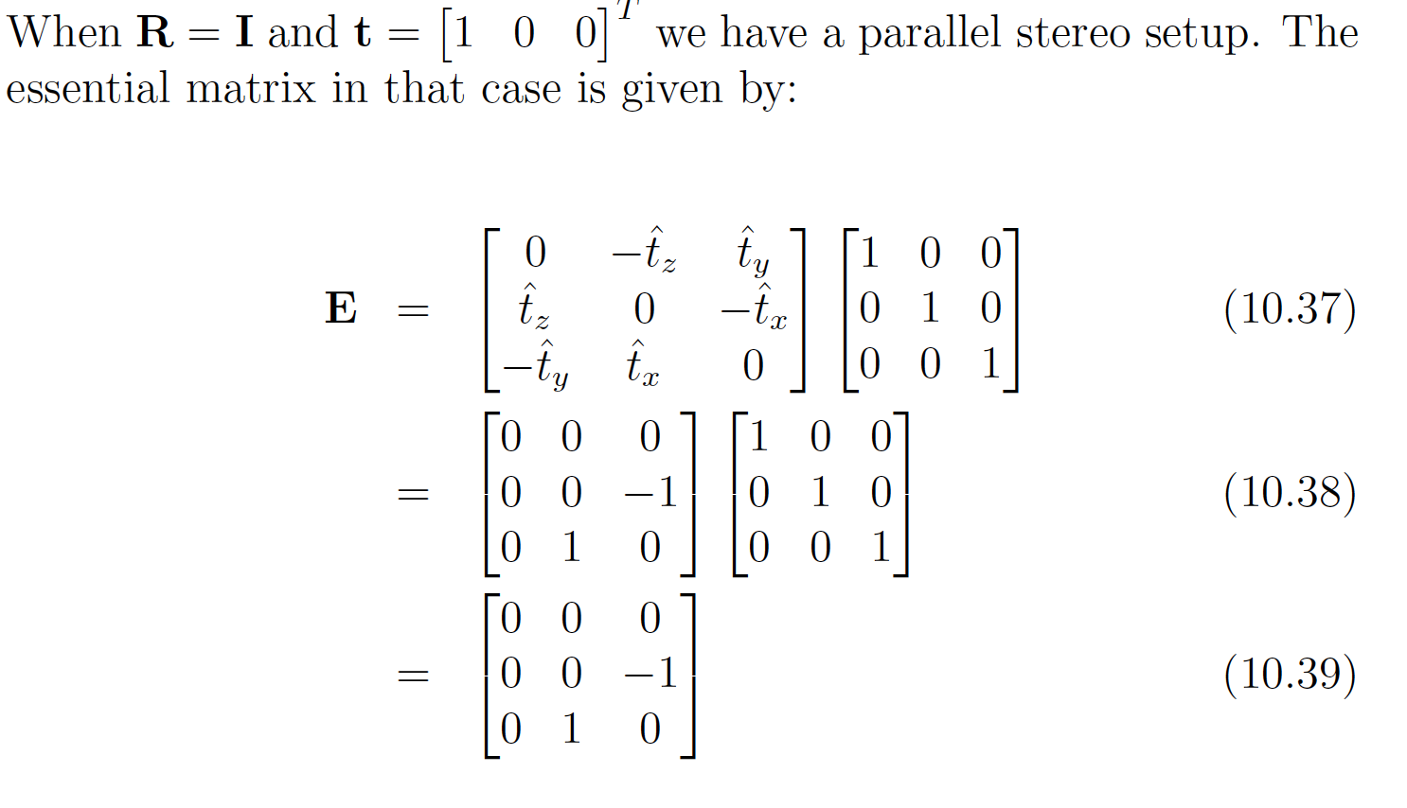

Slide 37
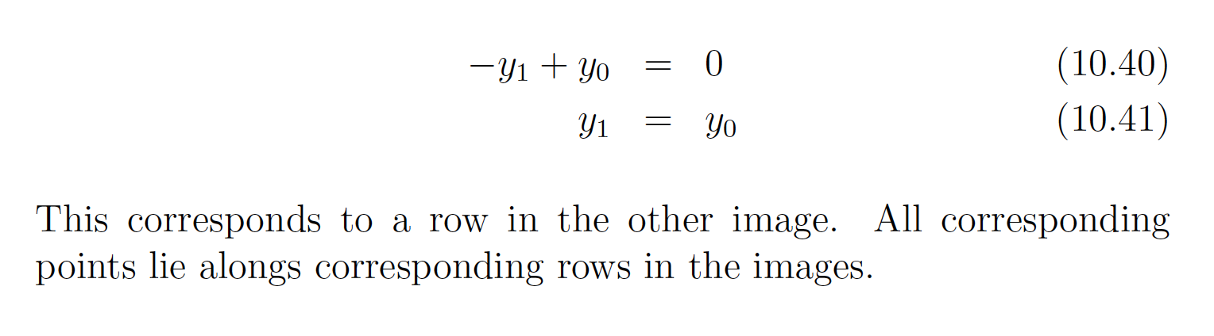
Epipolar lines for the setup

Slide 38

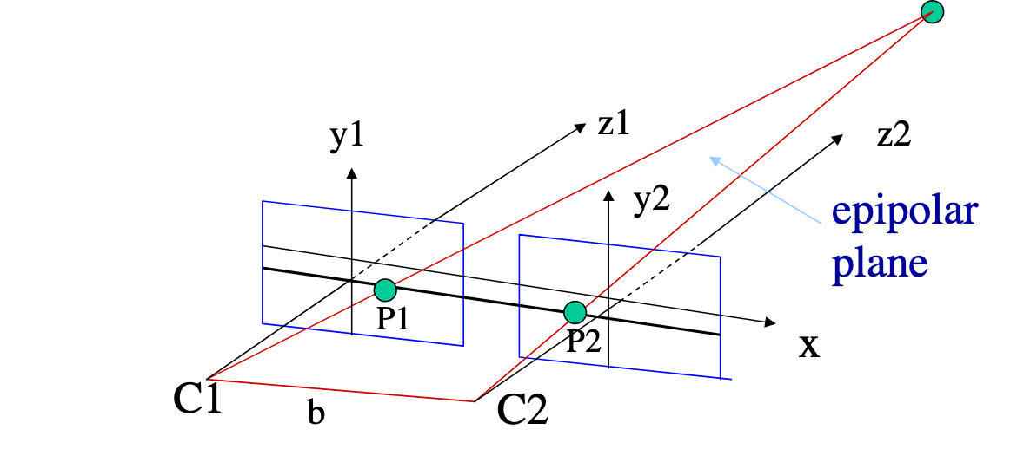
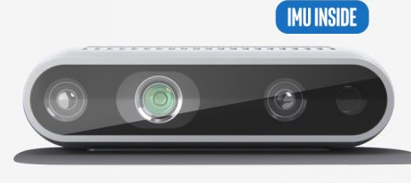
Parallel Stereo Setup
https://courses.cs.washington.edu/courses/cse455/09wi/Lects/lect16.pdf

Slide 39
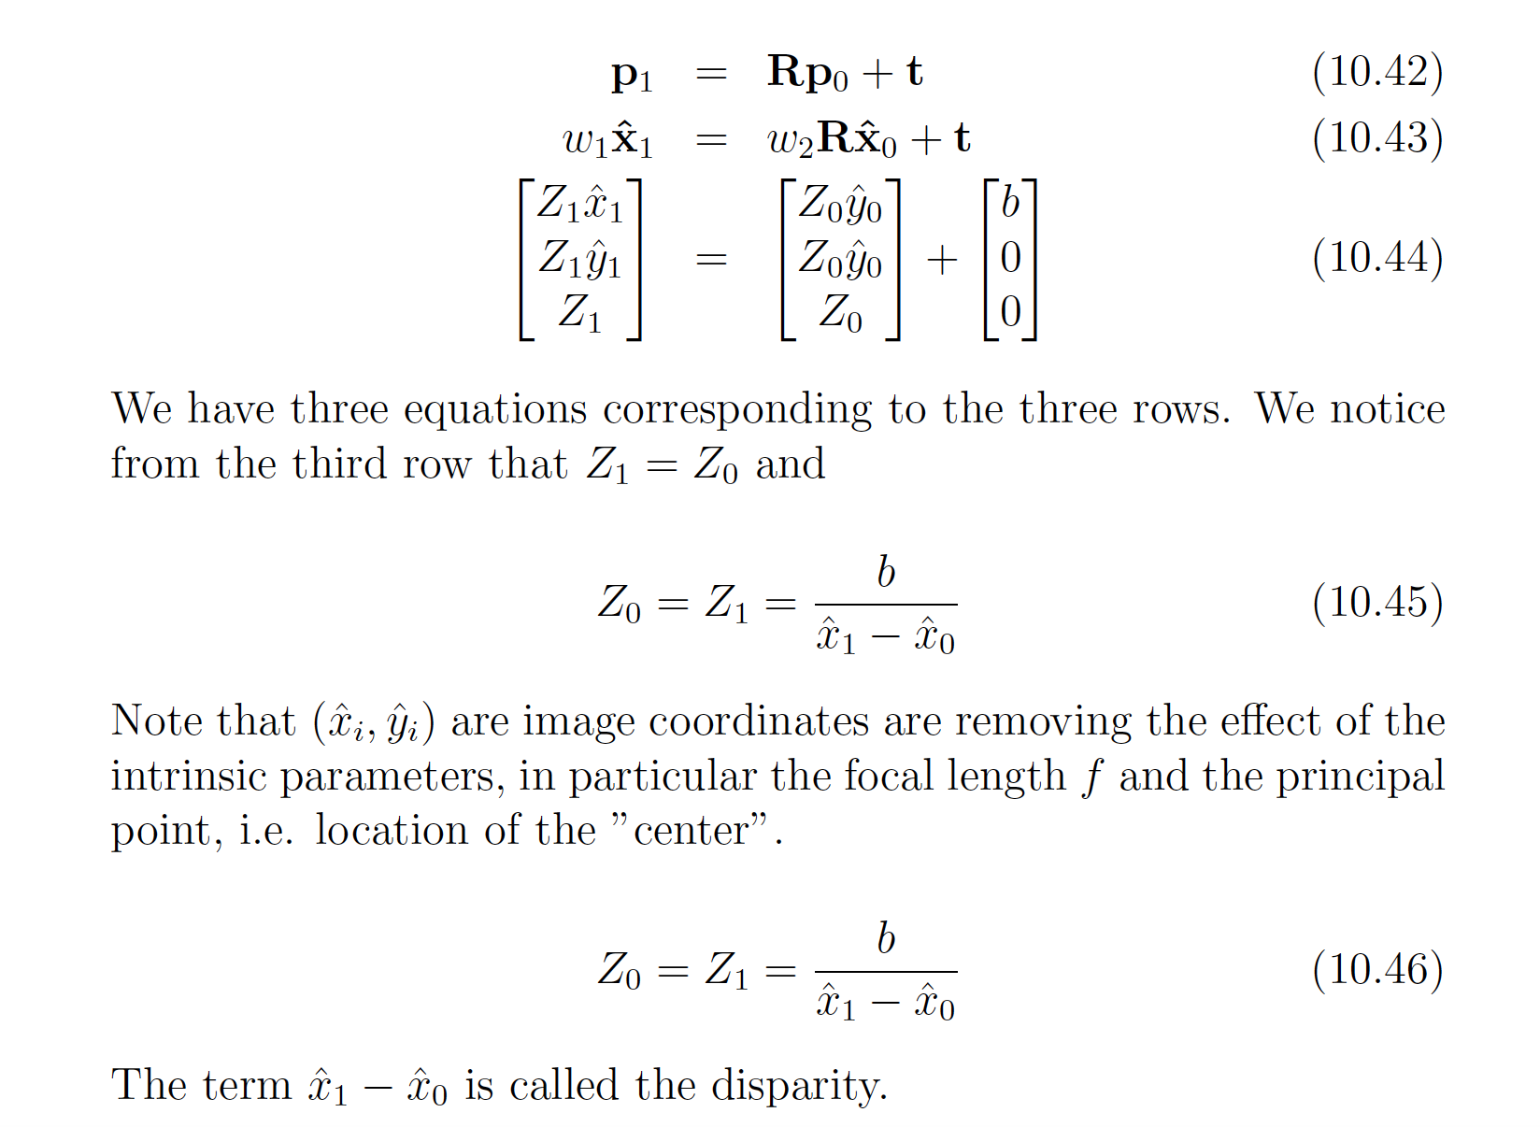
For stereo, R and t are known
Let the distance between the cameras be b – the baseline.
The translation vector is [b, 0, 0]^{T}

Slide 41
Dense depth – all pixels are points to match
Match pixels along the rows, based on their intensities;
Have to maintain piecewise smoothness both across rows and the columns

Slide 42
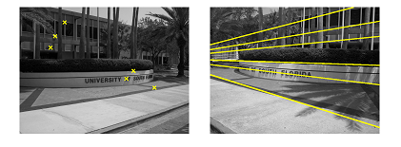
More to it -- Very Wideline Matching
A. S. Brahmachari and S. Sarkar, "Hop-Diffusion Monte Carlo for Epipolar Geometry Estimation between Very Wide-Baseline Images," in IEEE Transactions on Pattern Analysis and Machine Intelligence, vol. 35, no. 3, pp. 755-762, March 2013.

